Slide 1
Wells Fargo Hackathon - 2025
Topic : Gen AI-Based Data Profiling
Team : AI_Dynamos
Team Members
Nehru Komaravolu
Lakshman K Kethineedi
Kesava Karthik Shoroff
Shrey S Patel
Shreyas Bhat M

Slide 2


Problem Statement
Banks are required to file the regulatory reports to the Fed on a periodic basis. (Monthly/Quarterly/Yearly cadence)
Currently these regulatory reports which are generated and sent to fed might involve human errors leading to resubmission requests due to absence of automated pre-validation modules.
There exists a need to build some processes in place to implement AI based “unsupervised learning” tools that could interpret the rules and perform second level of validation before submission to Federal Govt.
Risks involved with the manual / automated IT processes :
Chances of banks reporting incorrect metrics as a result of human error (overstating/understating) due to logic’s encapsulated within their systems
Need for one more round of external manual/automated validations before it can be submitted to the Fed.
There is a need of building some validation routines so that inaccuracies are identified and fixed before these can be submitted to Fed.

Slide 3
Innovation & Benefits

Slide 4
Efficiency with Automation & Benefits
A front-end application that could provide the user with an intuitive way of providing feedback on the metrics generated and identified anomalies.
A utility/program capable of parsing the logics present in the FRS (Federal Reserve System) for the representative federal report there by generating a rule based engine (data profiling rules).
Self-service recommendations based on the anomalies observed and how to restore normalcy including automated explanations for auditors.
Module capable of running validation rules on the manually generated reports and determine any anomalies by parsing the rules provided by rule based engine.
GenAI – LLM (Un-supervised) | Python | Jupyter Notebook | React
Efficiency with Automation
Reduce the manual reporting effort.
Ensure regulatory submission on-time
Reduced manual data entry and validation
Ensure consistency across reports when dealing with multiple regulatory bodies
Automated systems capable of supporting audits and inspections more efficiently.
Easily adapt to new regulations and reporting templates without manual processes.
Benefits
Data Quality & Consistency : Ensures data meets predefined thresholds for accuracy , timeliness and completeness for all regulatory reporting attributes.
Avoid rework on resubmitting the reports with data issues.
Simplified the overall flow and brining efficiency in submitting regulatory reporting documents.
100% reduction in error rate.

Slide 5
Technical Approach and Solution Design

Slide 6
Solution Design & Workflow
Phase 1 : Read – Extract – Evaluate Rules
Upload FRY14Q Document
Uploads the FRS as an input to the tool through the portal
Use LLM to Extract & Interpret
Tool interprets and cleanses the rules which are available within the FRS
Display Raw Regulatory Rule
Rules extracted are displayed to the user for feedback and any corrections
Evaluate
Users evaluate the rules being interpreted by the LLM model and save to the backend
Phase 2 : Process – Evaluate – Identify - Recommend
Upload Dataset
Input the FRY 14QH1 Dataset as an input to the tool
Apply rules extracted
Tool evaluates the data in the dataset against rules extracted from FRS
Identify Anomalies
Identifies the anomalies along with the commentary indicating the issues with the dataset
Report
Provides recommendation on the issues observed and suggestions corrections

Slide 7
Scalability & Efficiency

Slide 8

Scalability of the solution
This solution has been designed a self service tool and is envisioned to work as an End to End solution which provides the users with ability to upload FRY-14Q H1 datasets easily.
This tool currently supports FRY-14Q H1 reports and can easily be scaled to be used for any other regulatory reports like FRY-14Q (A-H Schedules) reports / FRY-14M reports.
The tool can support any needs that come up in future as it provides for a “Train Model” option which enables users to upload any changes that comes up with the regulatory needs as part of FRS.
The code is written in a modularized format which enabled us to add any newer schedule reports without need for any major code refactoring.

Slide 9
Video Link for Demo
https://drive.google.com/file/d/1zmFLBFS3XNKdTiJO50pXJetoDKBudZcW/view?pli=1

Slide 10
Data Regulatory Compliance Lens Screens/UI
(Explainability & Interactivity)

Slide 11
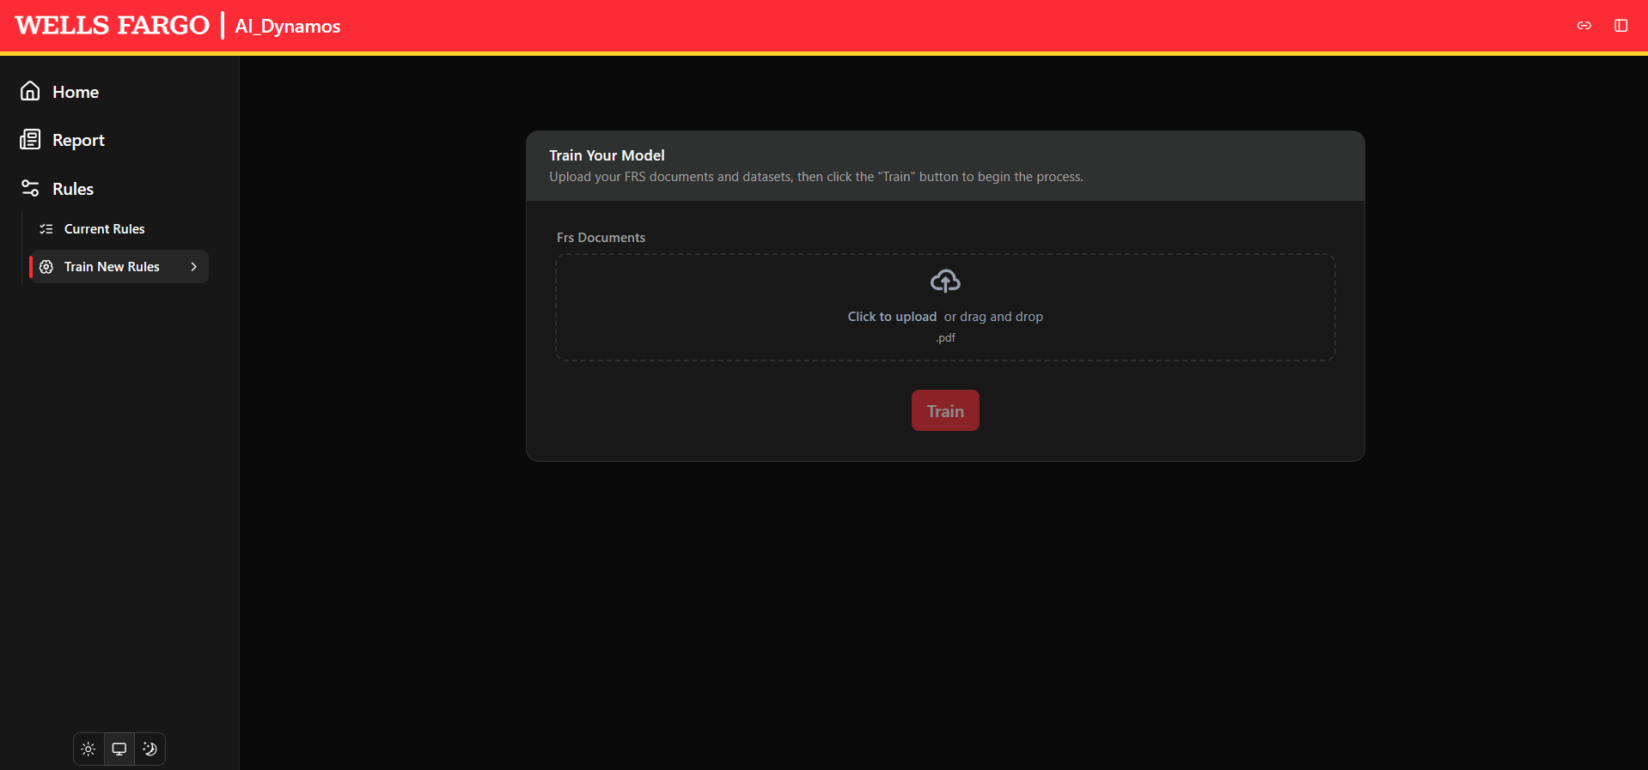
FRS-FRY14Q PDF Upload Screen

Slide 12
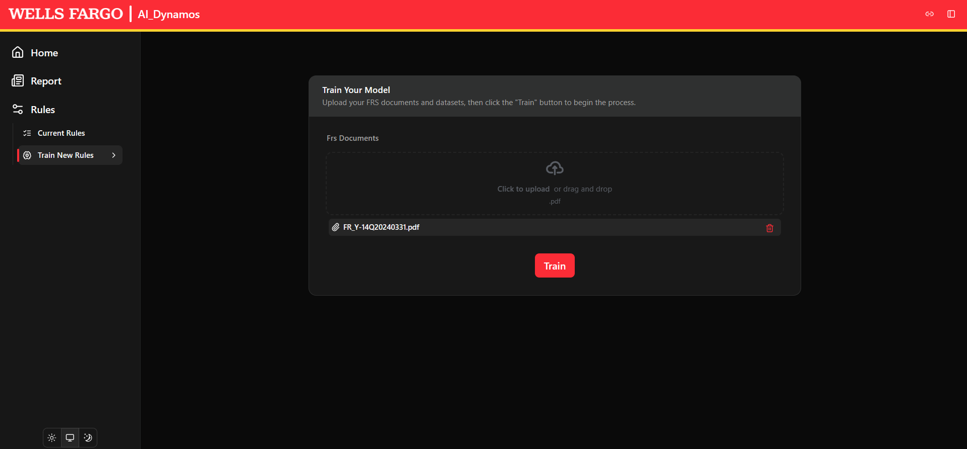
FRS-FRY14Q-Applying LLM Model

Slide 13
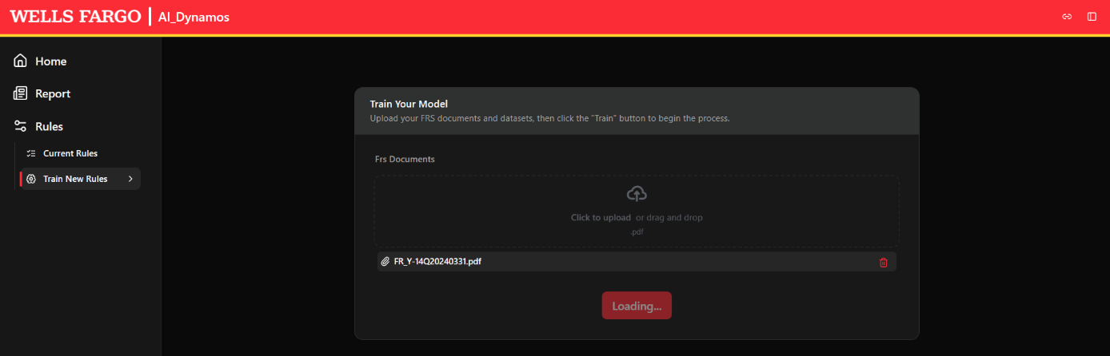
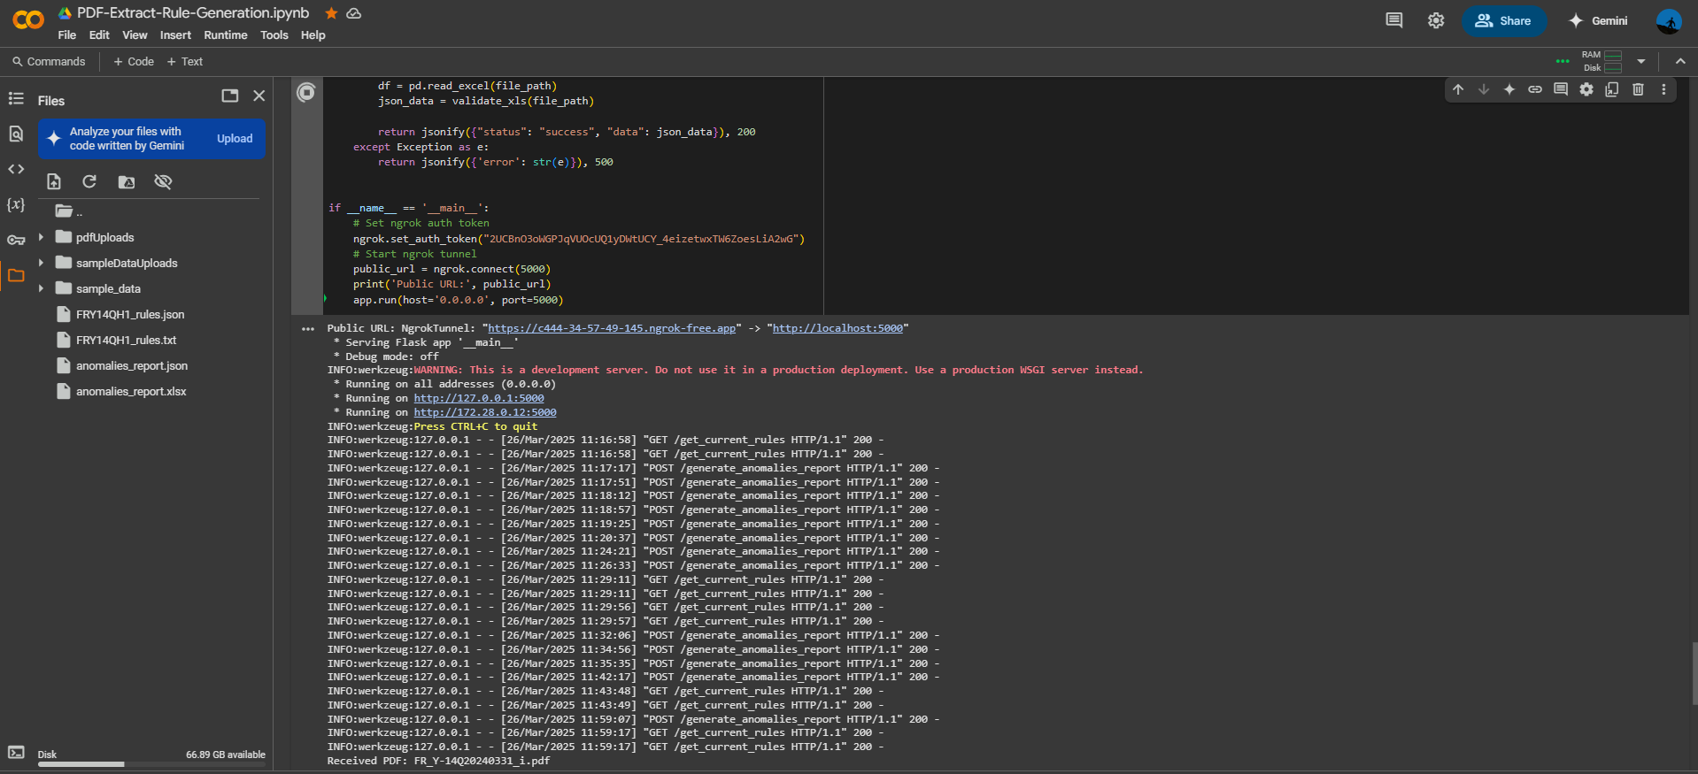
FRS-FRY14Q-Applying LLM Model

Slide 14
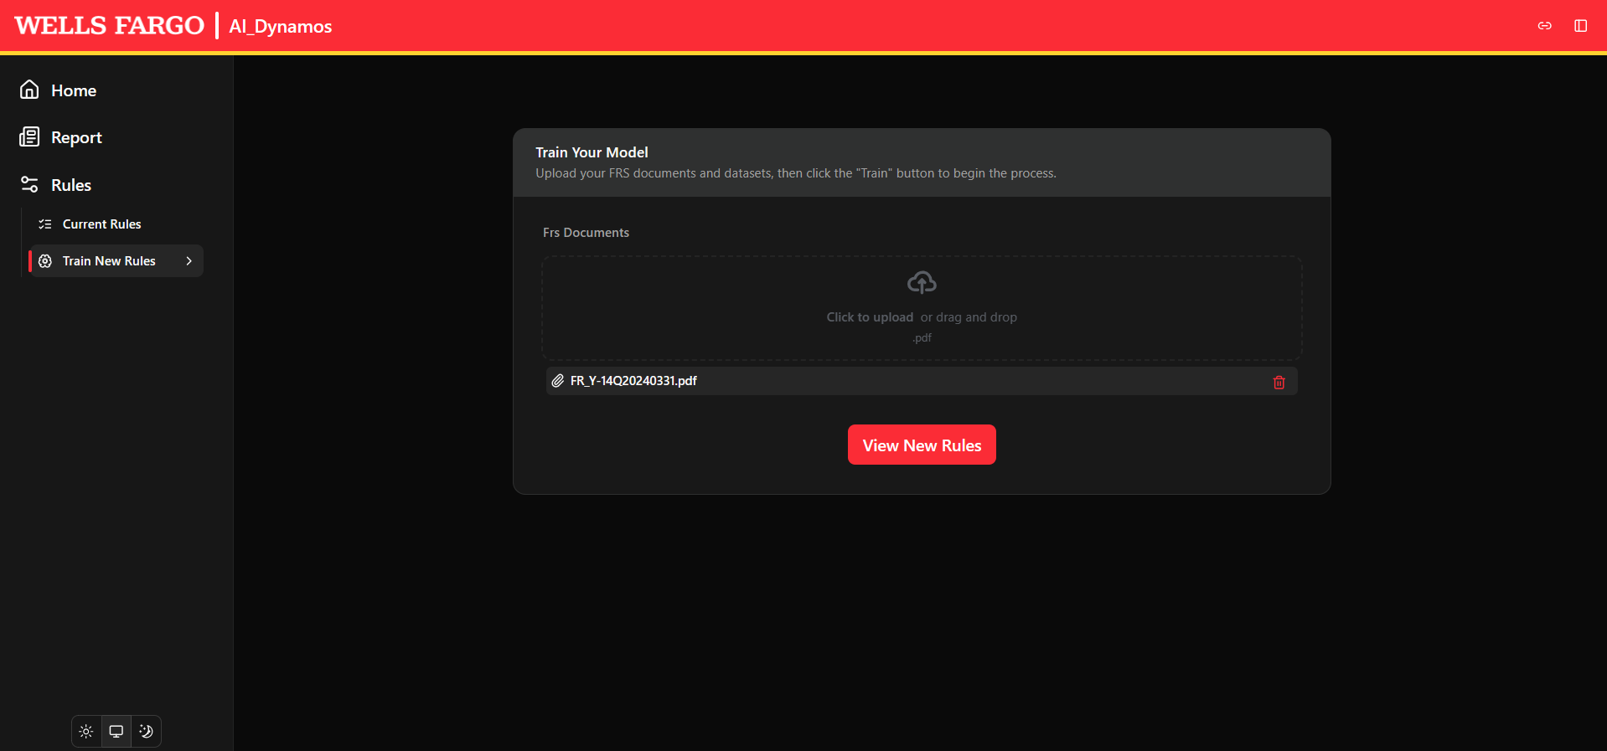
FRS-FRY14Q-View Regulatory Instructions/Rules

Slide 15
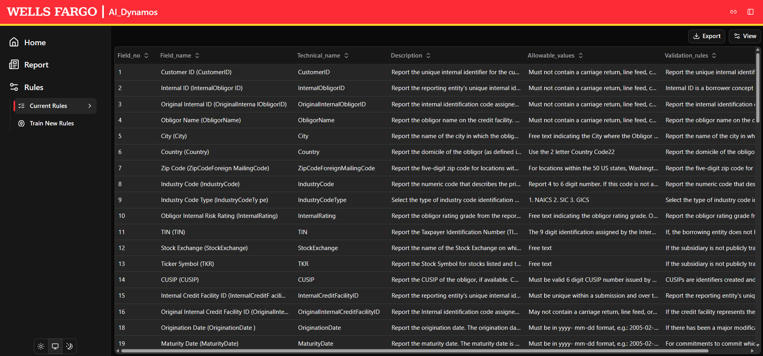
FRS-FRY14Q-Regulatory Instructions/Rules Report

Slide 16
Accuracy & Effectiveness

Slide 17
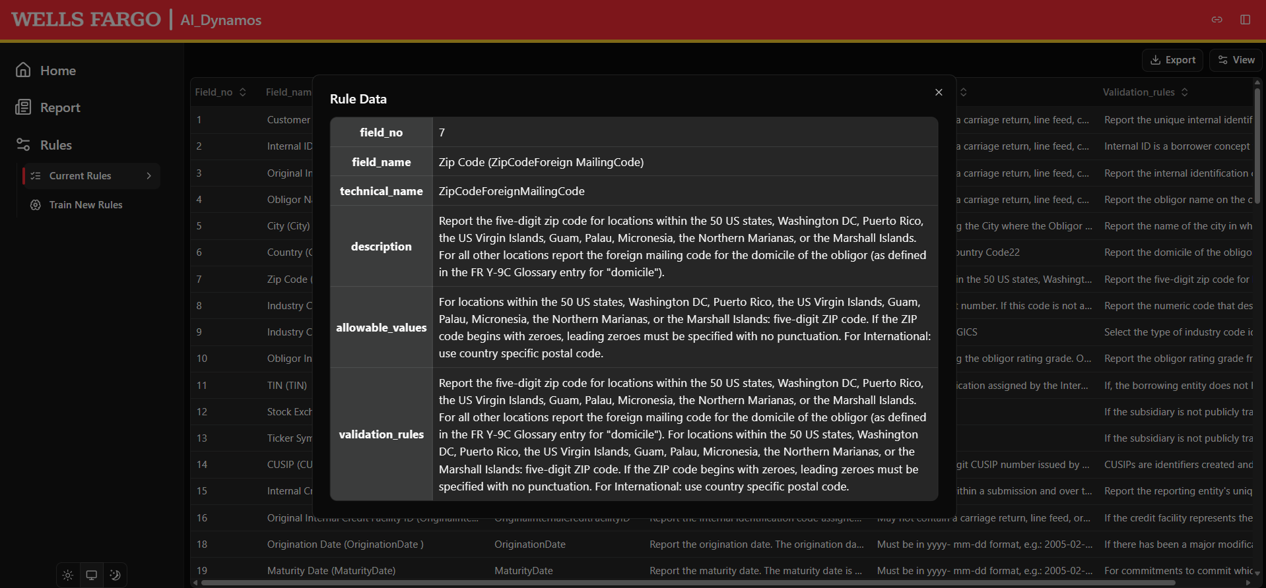
FRS-FRY14Q-Specific Regulatory Instruction/Rule Magnifier

Slide 18
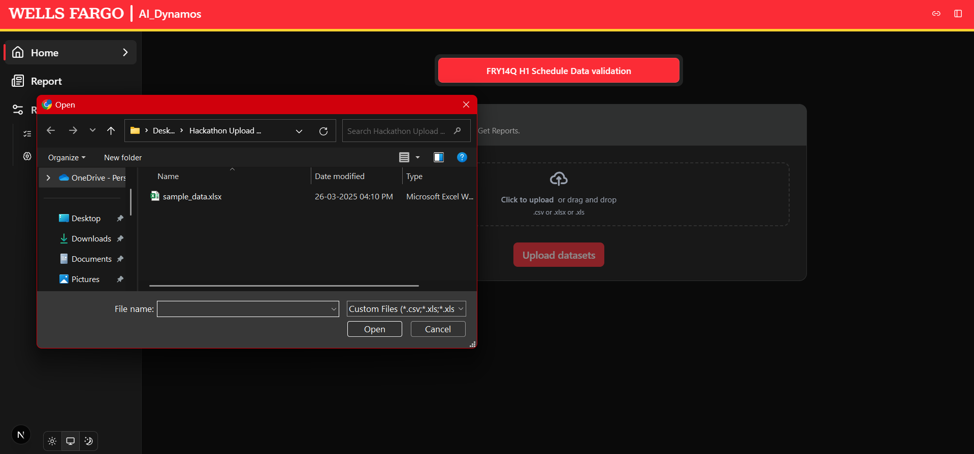
FRS-FRY14Q-Upload Schedule-H Dataset

Slide 19
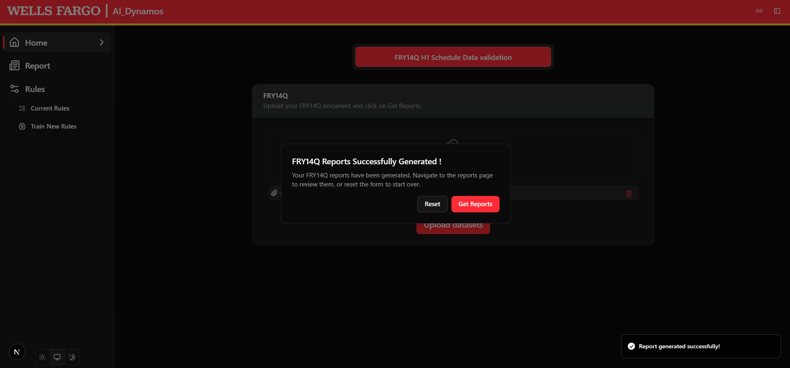
FRS-FRY14Q-Identify Anomalies

Slide 20
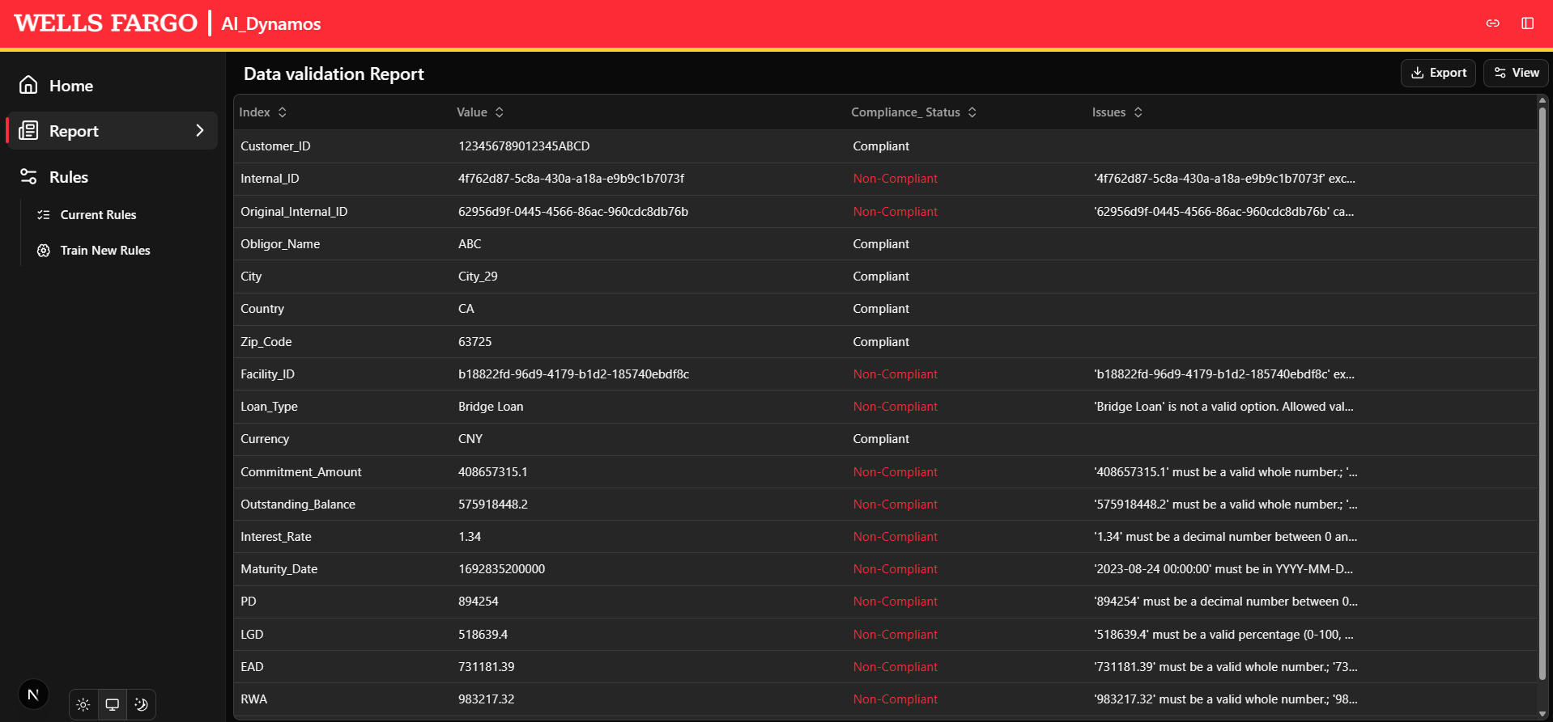
FRS-FRY14Q-Anomalies Based on Ruleset

Slide 21
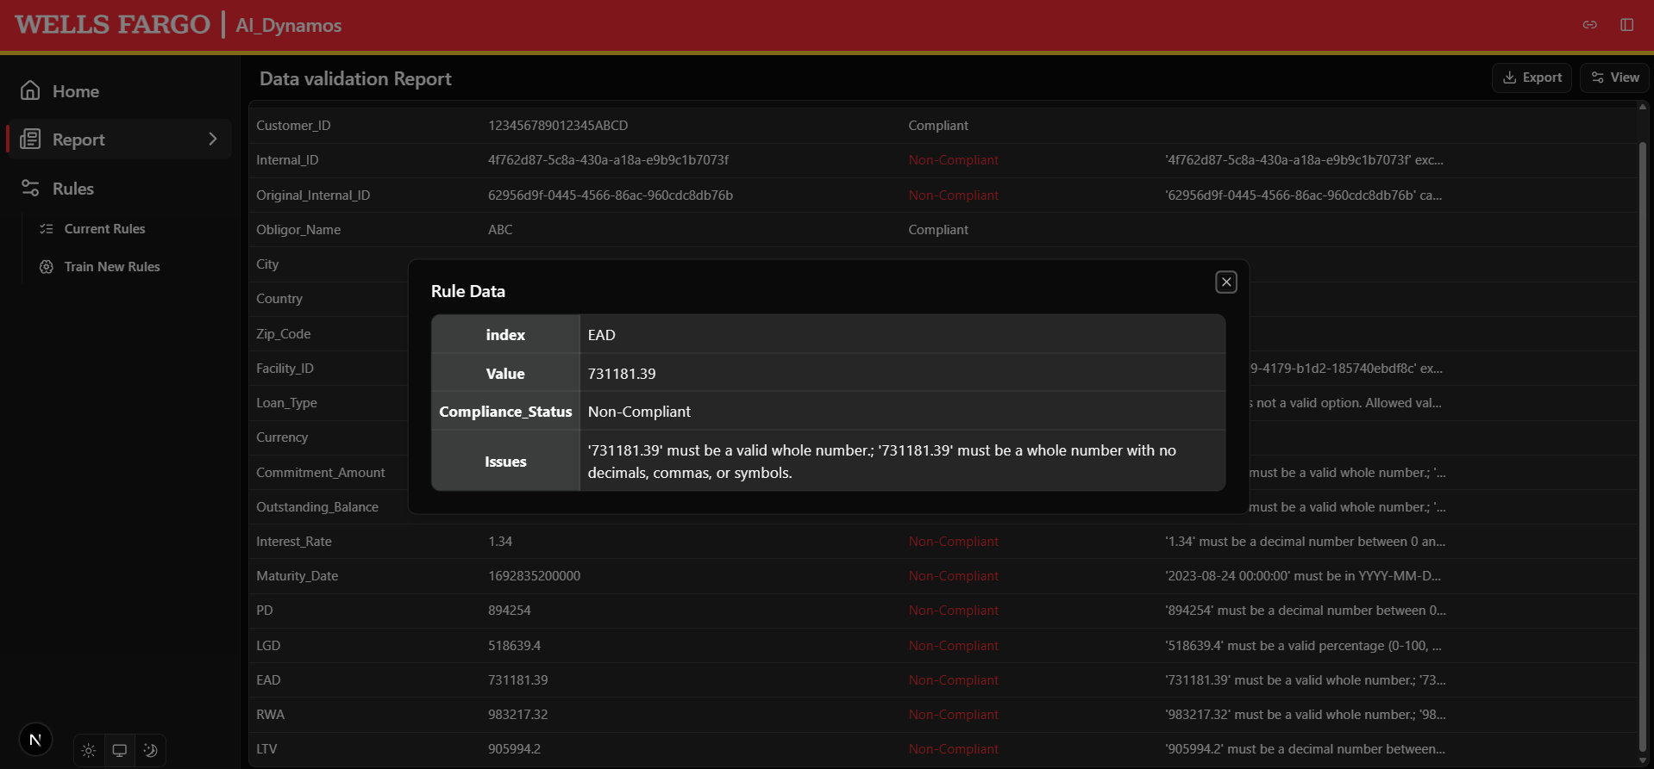
FRS-FRY14Q-Non-Compliant Field Magnifier

Slide 22
Thank you
Notes:
In Slide Show mode, click the arrow to enter the PowerPoint Getting Started Center.

